Slide 2
Cryptography

Slide 3
Activity: Spider Diagram
When do we need to send secure messages?

Slide 4
What is Steganography?

Slide 5
Steganography
Steganography is the practice of concealing messages or information within other non-secret messages or information. Steganography comes from the Greek Steganos, meaning concealed or covered, and Graphein, meaning writing.
Steganography is used to digitally watermark videos and pictures and sometimes used to send hidden messages.
Here are some examples when Steganography is used:
This is an example of how to hide a message within a message using the Bacon code

Slide 6
Steganography
Steganography works because the eavesdropper does not know where the message is hidden and maybe does not know there is even a hidden message in the first place!

Slide 7
Activity: Define Steganography

Slide 8
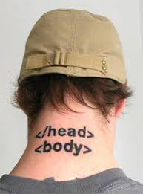
Histiaeus’s Servant
Back in ancient Greece, Histiaeus wanted to send a message to his friend.
But he was worried the message would be intercepted and read by his enemies.
If the message was written on a plain piece of paper, it would be quickly found and read if the messenger was captured and searched.

Slide 9
Histiaeus’s Servant
So Histiaeus needed to hide the message.
He shaved the head of his most trusted servant and tattooed the message on the back of their head.
When the servant’s hair had grown back, the message would be concealed.
If the messenger was captured and searched it wouldn’t be found.

Slide 10
Activity: Histiaeus’s Servant

Slide 11
Problems with the System?

Slide 12
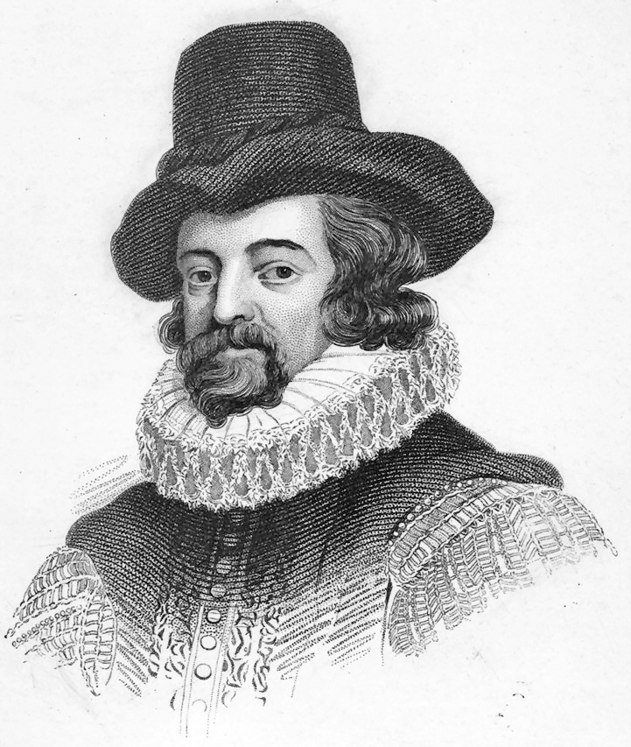
Sir Francis Bacon
He came up the idea that knowledge should be based only on inductive reasoning and observations, also known as the scientific method.
He came up with a Steganographic method of hiding messages by using different fonts.

Slide 13
The Bacon Cipher
The Bacon cipher is a method of hiding a message inside another message by changing fonts.
Write out the message we want to hide.
Choose 2 different font types, A and B, such as bold and italic or Comic Sans and Edwardian Script.
Write out a boring message with at least 5 times as many letters in it as the hidden message.
Change the font of the boring message from style A to B for each of the corresponding letters in the hidden message.

Slide 14
Example
a: AAAAA | h: AABBB | o: ABBBA | v: BABAB
b: AAAAB | i: ABAAA | p: ABBBB | w: BABBA
c: AAABA | j: ABAAB | q: BAAAA | x: BABBB
d: AAABB | k: ABABA | r: BAAAB | y: BBAAA
e: AABAA | l: ABABB | s: BAABA | z: BBAAB
f: AABAB | m: ABBAA | t: BAABB
g: AABBA | n: ABBAB | u: BABAA
Bacon message: I WENt TO SCHOOL tODay, iT Was RaInING. nO I dO NOt lIKe it WHen iT RAIns

Slide 15
Example
a: AAAAA | h: AABBB | o: ABBBA | v: BABAB
b: AAAAB | i: ABAAA | p: ABBBB | w: BABBA
c: AAABA | j: ABAAB | q: BAAAA | x: BABBB
d: AAABB | k: ABABA | r: BAAAB | y: BBAAA
e: AABAA | l: ABABB | s: BAABA | z: BBAAB
f: AABAB | m: ABBAA | t: BAABB
g: AABBA | n: ABBAB | u: BABAA
Bacon message: I WENt TO SCHOOL tODay, iT Was RaInING. nO I dO NOt lIKe it WHen iT RAIns
Font type A: UPPERCASE
Font type B: lowercase

Slide 16
Example
a: AAAAA | h: AABBB | o: ABBBA | v: BABAB
b: AAAAB | i: ABAAA | p: ABBBB | w: BABBA
c: AAABA | j: ABAAB | q: BAAAA | x: BABBB
d: AAABB | k: ABABA | r: BAAAB | y: BBAAA
e: AABAA | l: ABABB | s: BAABA | z: BBAAB
f: AABAB | m: ABBAA | t: BAABB
g: AABBA | n: ABBAB | u: BABAA
Bacon message: I WENt TO SCHOOL tODay, iT Was RaInING. nO I dO NOt lIKe it WHen iT RAIns
Font type A: UPPERCASE
Font type B: lowercase
Translated: AAAAB
Hidden message: B

Slide 17
Example
a: AAAAA | h: AABBB | o: ABBBA | v: BABAB
b: AAAAB | i: ABAAA | p: ABBBB | w: BABBA
c: AAABA | j: ABAAB | q: BAAAA | x: BABBB
d: AAABB | k: ABABA | r: BAAAB | y: BBAAA
e: AABAA | l: ABABB | s: BAABA | z: BBAAB
f: AABAB | m: ABBAA | t: BAABB
g: AABBA | n: ABBAB | u: BABAA
Bacon message: I WENt TO SCHOOL tODay, iT Was RaInING. nO I dO NOt lIKe it WHen iT RAIns
Font type A: UPPERCASE
Font type B: lowercase
Translated: AAAAB AAAAA
Hidden message: Ba

Slide 18
Example
a: AAAAA | h: AABBB | o: ABBBA | v: BABAB
b: AAAAB | i: ABAAA | p: ABBBB | w: BABBA
c: AAABA | j: ABAAB | q: BAAAA | x: BABBB
d: AAABB | k: ABABA | r: BAAAB | y: BBAAA
e: AABAA | l: ABABB | s: BAABA | z: BBAAB
f: AABAB | m: ABBAA | t: BAABB
g: AABBA | n: ABBAB | u: BABAA
Bacon message: I WENt TO SCHOOL tODay, iT Was RaInING. nO I dO NOt lIKe it WHen iT RAIns
Font type A: UPPERCASE
Font type B: lowercase
Translated: AAAAB AAAAA AAABA
Hidden message: Bac

Slide 19
Example
a: AAAAA | h: AABBB | o: ABBBA | v: BABAB
b: AAAAB | i: ABAAA | p: ABBBB | w: BABBA
c: AAABA | j: ABAAB | q: BAAAA | x: BABBB
d: AAABB | k: ABABA | r: BAAAB | y: BBAAA
e: AABAA | l: ABABB | s: BAABA | z: BBAAB
f: AABAB | m: ABBAA | t: BAABB
g: AABBA | n: ABBAB | u: BABAA
Bacon message: I WENt TO SCHOOL tODay, iT Was RaInING. nO I dO NOt lIKe it WHen iT RAIns
Font type A: UPPERCASE
Font type B: lowercase
Translated: AAAAB AAAAA AAABA ABBBA
Hidden message: Baco

Slide 20
Example
a: AAAAA | h: AABBB | o: ABBBA | v: BABAB
b: AAAAB | i: ABAAA | p: ABBBB | w: BABBA
c: AAABA | j: ABAAB | q: BAAAA | x: BABBB
d: AAABB | k: ABABA | r: BAAAB | y: BBAAA
e: AABAA | l: ABABB | s: BAABA | z: BBAAB
f: AABAB | m: ABBAA | t: BAABB
g: AABBA | n: ABBAB | u: BABAA
Bacon message: I WENt TO SCHOOL tODay, iT Was RaInING. nO I dO NOt lIKe it WHen iT RAIns
Font type A: UPPERCASE
Font type B: lowercase
Translated: AAAAB AAAAA AAABA ABBBA ABBAB
Hidden message: Bacon

Slide 21
Example
a: AAAAA | h: AABBB | o: ABBBA | v: BABAB
b: AAAAB | i: ABAAA | p: ABBBB | w: BABBA
c: AAABA | j: ABAAB | q: BAAAA | x: BABBB
d: AAABB | k: ABABA | r: BAAAB | y: BBAAA
e: AABAA | l: ABABB | s: BAABA | z: BBAAB
f: AABAB | m: ABBAA | t: BAABB
g: AABBA | n: ABBAB | u: BABAA
Bacon message: I WENt TO SCHOOL tODay, iT Was RaInING. nO I dO NOt lIKe it WHen iT RAIns
Font type A: UPPERCASE
Font type B: lowercase
Translated: AAAAB AAAAA AAABA ABBBA ABBAB …
Hidden message: Bacon is good

Slide 22
Activity: Bacon Cipher Practice
a: AAAAA | h: AABBB | o: ABBBA | v: BABAB
b: AAAAB | i: ABAAA | p: ABBBB | w: BABBA
c: AAABA | j: ABAAB | q: BAAAA | x: BABBB
d: AAABB | k: ABABA | r: BAAAB | y: BBAAA
e: AABAA | l: ABABB | s: BAABA | z: BBAAB
f: AABAB | m: ABBAA | t: BAABB
g: AABBA | n: ABBAB | u: BABAA
ChoCOLAtE CaKEs ArE TaSTY WE ALSo lOVE pIE
THe grAsS IS GREenEr WHERe yOu WAteR
ChEeSEY cHIps YUM
tHe qUICk brOWn FOX juMpS oVER tHE lAZy Dog aNd SO Did I. iT IS vERY fun
Extension: Create your own hidden message using two different colour
pens or a pen and a pencil

Slide 23
Problems with the Bacon Cipher?

Slide 24
Extension Activity: Make Your Own Invisible Ink

Slide 25
RECAP

Slide 26
Activity: What is Cryptography?

Slide 27
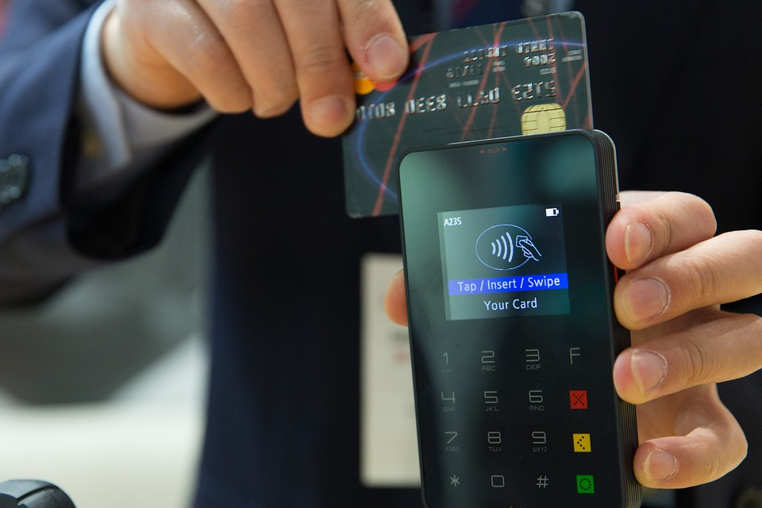
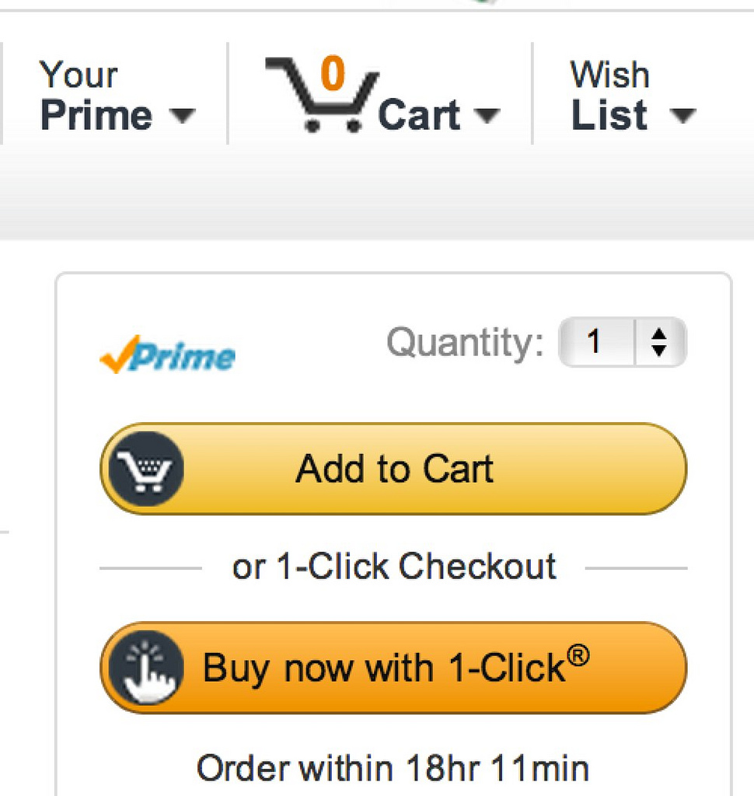
Cryptography
Cryptography is the practice and study of techniques for secure communication.
Cryptography comes from the Greek Kryptos, meaning secret or hidden, and Graphein, meaning writing.
Cryptographic techniques are used all the time in day to day life without you even noticing.
Here are some examples of when Cryptography is used:

Slide 28
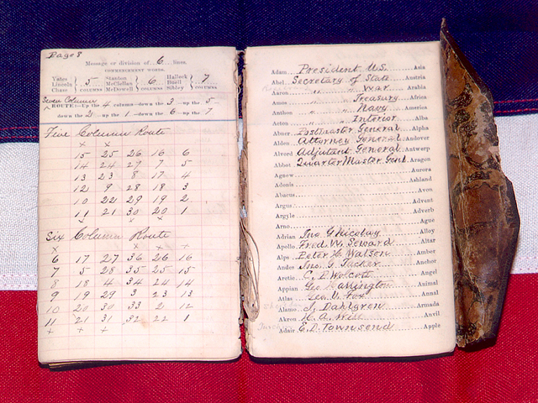
Cryptography
Cryptography is different from Steganography.
In Cryptography, everyone can tell that a secret message has been sent.
The security comes from the difficulty in decrypting the message without knowing the specific key that has been used.

Slide 29
Activity: Define Cryptography

Slide 30
Code Books
One Cryptographic method that is commonly used is based on code books.
We write an entire dictionary type book that changes the meaning of words or phrases.
We have a copy and the receiver has a copy.
We write out our message and encrypt each word or phrase in the message according to our code book.
Our receiver decrypts the message using an identical copy of the code book.

Slide 31
Activity: Make Your Own Code Book

Slide 32
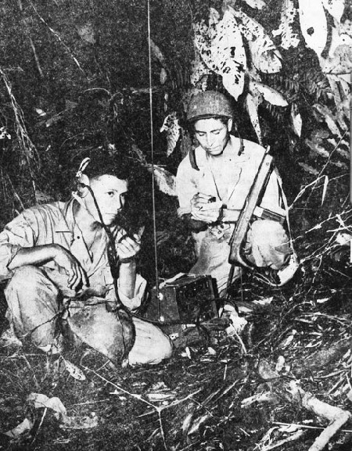
Code Talkers
Code books are like translating to another language, assuming that someone who intercepts the message doesn’t speak the encrypted language.
This idea has been used during both world wars as an encryption technique.
Amazingly, even Welsh has been used for these purposes as not many people outside of Wales can speak Welsh.

Slide 33
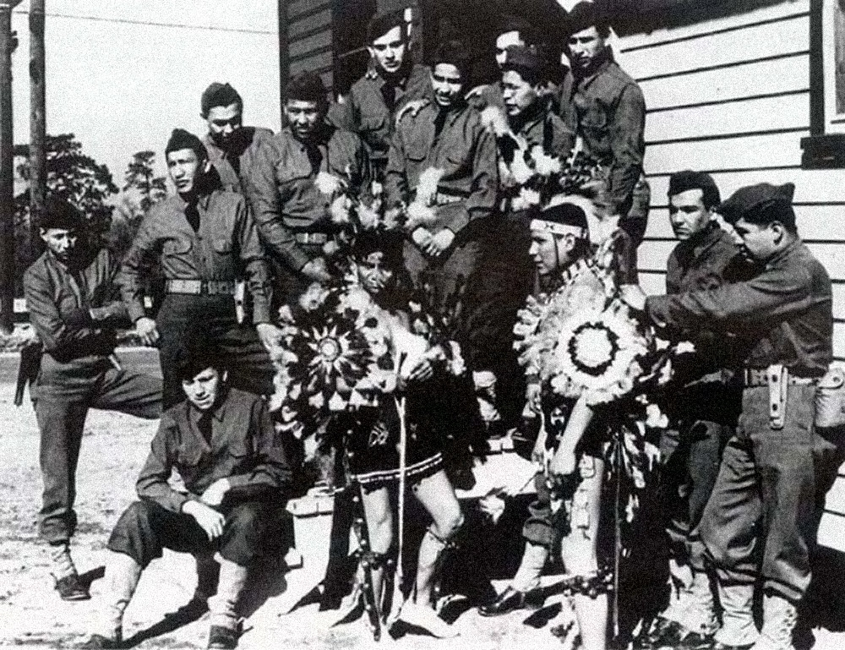
Navajo
The most prevalent use of translating to another language was with Navajo people.
In WWII, members of the Navajo population were put into different platoons to send encrypted messages by translating the English message to Navajo.
As very few people outside of the small Navajo community can speak Navajo, the Japanese found the code impossible to break.

Slide 34
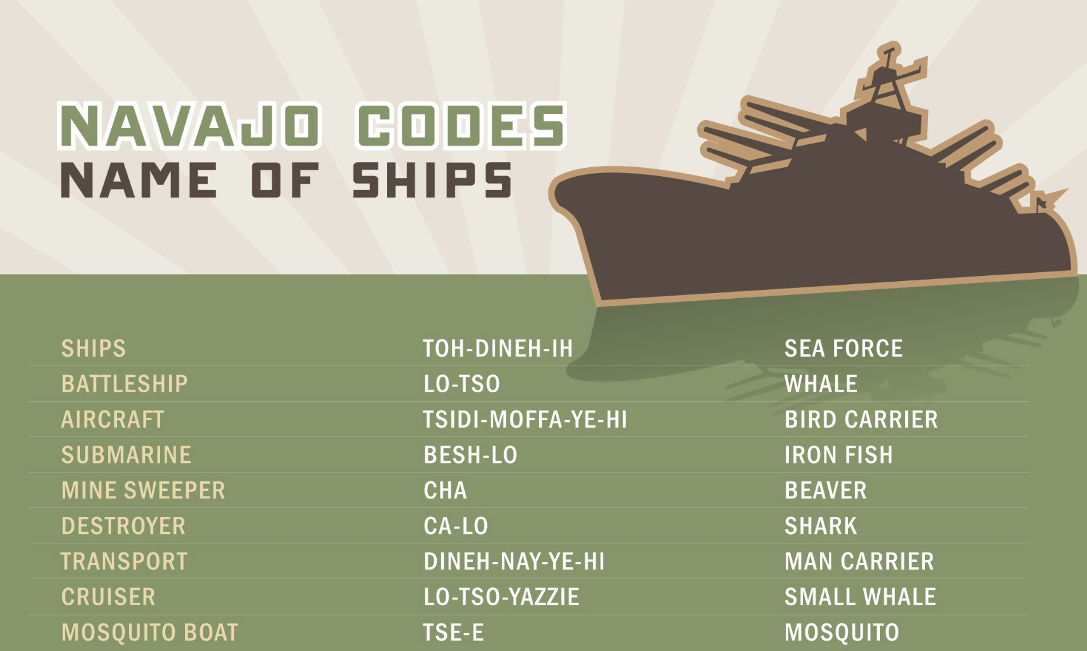

Slide 36
Pig Pen Cipher
The Pig Pen Cipher has been used throughout history by a secret group called the Freemasons.
The Freemasons are kind of like a secret club. They have secret handshakes, codes and rituals that they aren’t supposed to share with the outside world.
Each letter in your plaintext message is encrypted using the grid.
The weird symbols are sent as the message and the receiver decrypts them.
Notes:
They are called as pigpens because the symbols look a bit like pigpens, with the straight lines being the sides of the pen and the dots being the pigs.

Slide 37
Activity: Pig Pen Practice

Slide 38
Codes vs. Ciphers

Slide 39
Codes vs. Ciphers
Codes encrypt entire words and/or phrases in the plaintext and decrypt entire words and/or phrases in the ciphertext.
Ciphers encrypt individual letters in the plaintext and decrypt individual letters in the ciphertext.
Code:
Hello my name is Luke -> Shwmae Luke ydw i
Cipher:
Hello my name is Luke ->

Slide 40
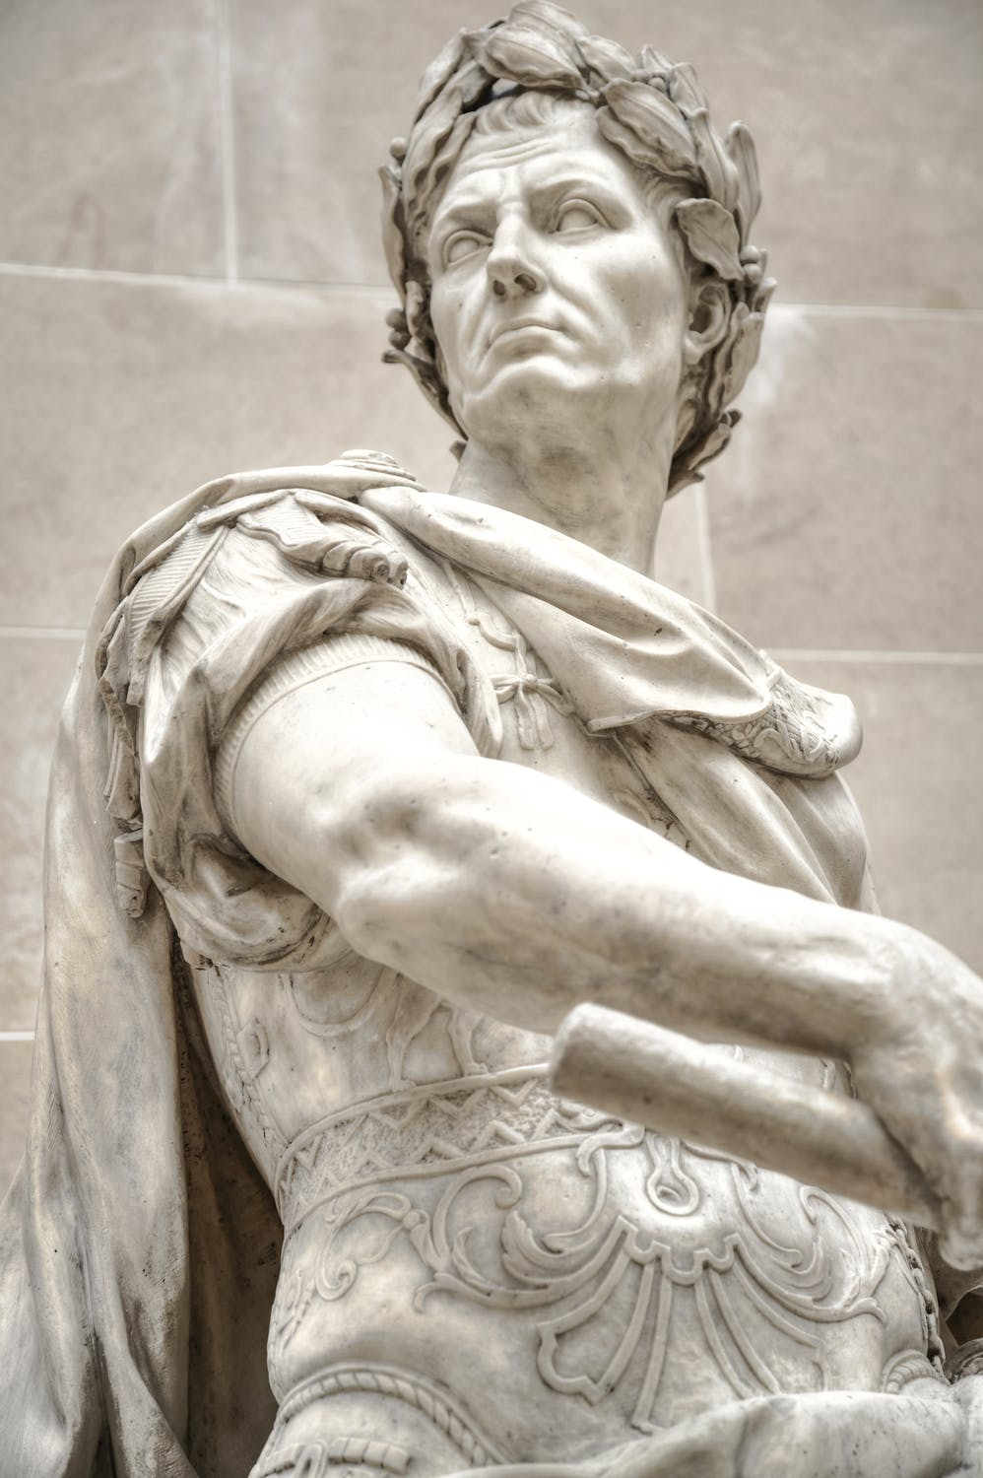
Julius Caesar
Gaius Julius Caesar:
100BC - 44 BC.
A Roman politician, dictator, military general and historian.
Led 2 expeditions to Britain in 55 BC and 54 BC.
Elected to Consul, the highest rank in the Roman army, when he was 40 years old.
In his 20s he was captured by pirates.
Assassinated in the senate by republican senators.
As a military general he devised a method of encryption which is called the Caesar cipher.

Slide 41
Activity: Julius Caesar Fact File

Slide 42
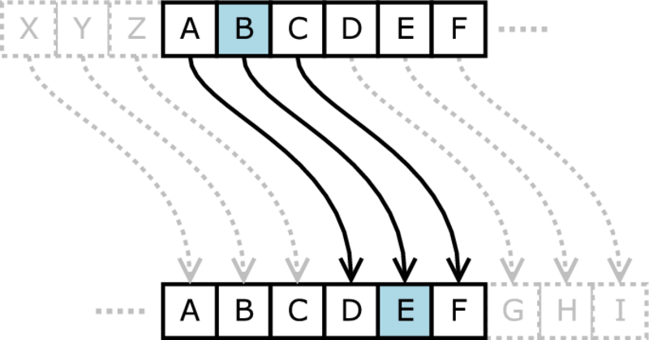
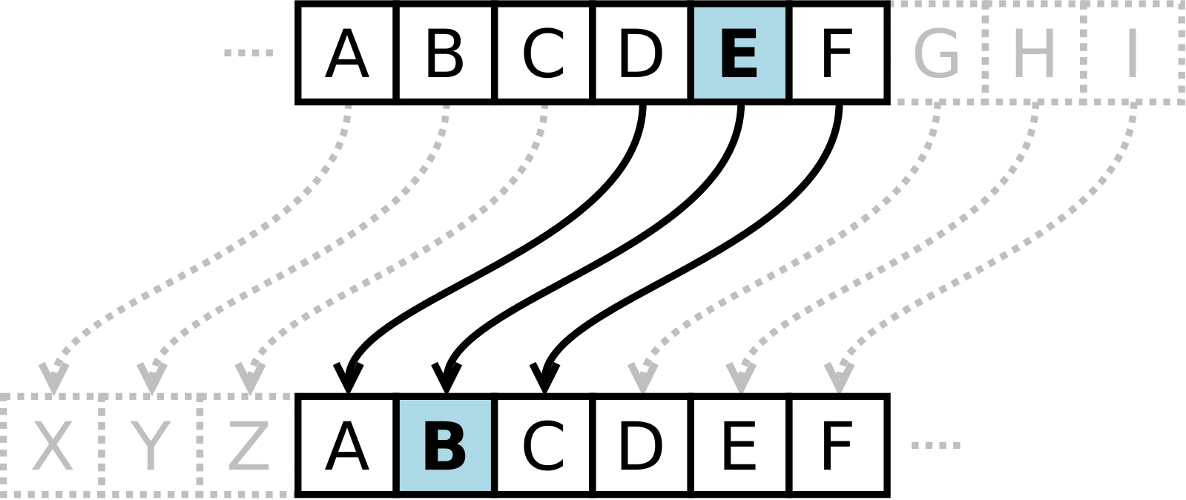
The Caesar Cipher
The Caesar Cipher is a shift cipher with key 3.
During encryption every letter in the plaintext message is shifted forward 3 letters in the alphabet. The letter “A” is encrypted as the letter “D”.
During decryption, the receiver shifts each letter in ciphertext backward 3 letters. The letter “E” is decrypted to mean the letter “B”.
For example:
Plaintext: Hello world
Ciphertext: Khoor zruog

Slide 43
Activity: Cipher Wheel Cut Out

Slide 44
Activity: Shift Cipher Practice
Caesar cipher, Key= 3:
Whfkqrfdpsv lv ehwwhu wkdq vfkrro zrun
Brx’uh jrqqd qhhg d eljjhu erdw
Key = 9:
Cxcx r’en j onnurwp fn’an wxc rw tjwbjb jwhvxan
Key = 21:
Yj jm yj ijo. Oczmz dn ij omt
Extension: Key not given
Z druv r gifdzjv di wifuf. R gifdzjv. “Ufe’k pfl cvrmv yzd jrdnzjv xrdxvv” reu z ufe’k dvre kf

Slide 45
How Hard is it to Break a Shift Cipher?

Slide 46
RECAP

Slide 47
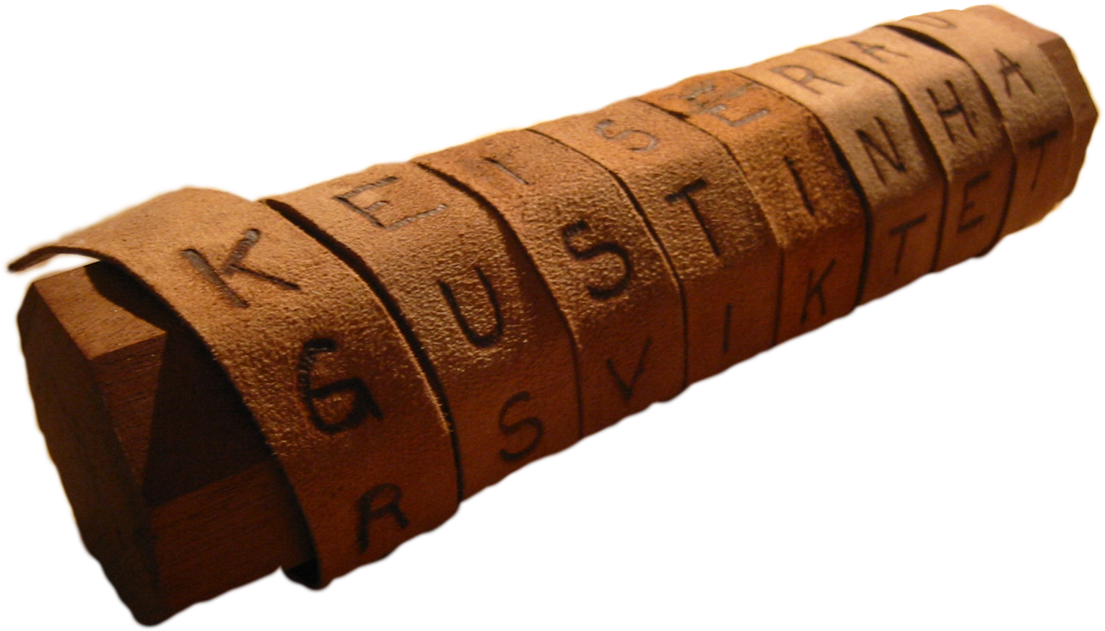
Transposition Ciphers
All the cryptographic techniques so far have involved replacing words or letters with other words or letters. These can be thought of as substitution methods.
What about if we instead jumbled up the order of the letters?
We would create a very hard anagram that needs to be broken, unless you knew how we jumbled them up.
These are known as transposition ciphers.

Slide 48
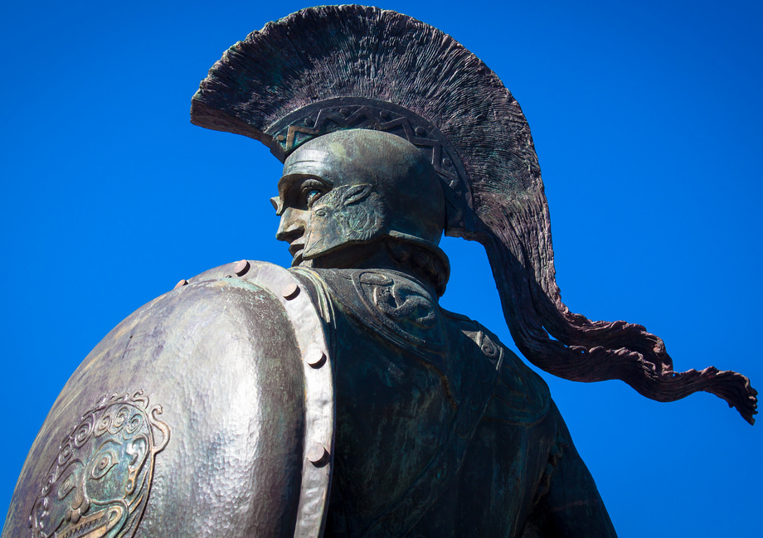
Scytale
Back in ancient Sparta, transposition ciphers were used to send messages using a wooden cylinder called a Scytale.
Two identical cylinders were created.
A long and narrow piece of material, normally leather, was wrapped around the Scytale and the message was written across it.
After the message had been written, the material was unwound and sent as one long list of letters.
The recipient wrapped the message around their identical Scytale and read the message.

Slide 49
Activity: Scytale

Slide 50
Rail Fence Cipher
The Rail Fence cipher is another transposition cipher.
Write out the message in a zig zag like pattern on a certain number of “rails”.
Read the message along the rails and send it to the receiver.
The receiver writes the message back out across the same number of rails and reads the message.
The number of rails acts as the key in this system.
For example:
Key = 4
Plaintext: this is a secret message
Ciphertext: tatghssemaeiieresscs

Slide 51
Rail Fence Cipher Example
Let’s say the message we received was “TATGHSSEMAEIIERESSCS” and the key was four.

Slide 52
Rail Fence Cipher Example
Let’s say the message we received was “TATGHSSEMAEIIERESSCS” and the key was four.
Draw a zig zag out along the 4 rails with as many boxes as letters in the message.

Slide 53
Rail Fence Cipher Example
We write out the message along four rails in the correct boxes given to us by a zig zag pattern.
Message: “TATGHSSEMAEIIERESSCS”
T

Slide 54
Rail Fence Cipher Example
We write out the message along four rails in the correct boxes given to us by a zig zag pattern.
Message: “TATGHSSEMAEIIERESSCS”
T |  |  |  |  |  | A

Slide 55
Rail Fence Cipher Example
We write out the message along four rails in the correct boxes given to us by a zig zag pattern.
Message: “TATGHSSEMAEIIERESSCS”
T |  |  |  |  |  | A |  |  |  |  |  | T

Slide 56
Rail Fence Cipher Example
We write out the message along four rails in the correct boxes given to us by a zig zag pattern.
Message: “TATGHSSEMAEIIERESSCS”
T |  |  |  |  |  | A |  |  |  |  |  | T |  |  |  |  |  | G

Slide 57
Rail Fence Cipher Example
We write out the message along four rails in the correct boxes given to us by a zig zag pattern.
Message: “TATGHSSEMAEIIERESSCS”
T |  |  |  |  |  | A |  |  |  |  |  | T |  |  |  |  |  | G
 | H |  |  |  | S |  | S |  |  |  | E |  | M |  |  |  | A |  | E

Slide 58
Rail Fence Cipher Example
We write out the message along four rails in the correct boxes given to us by a zig zag pattern.
Message: “TATGHSSEMAEIIERESSCS”
T |  |  |  |  |  | A |  |  |  |  |  | T |  |  |  |  |  | G
 | H |  |  |  | S |  | S |  |  |  | E |  | M |  |  |  | A |  | E
 |  | I |  | I |  |  |  | E |  | R |  |  |  | E |  | S

Slide 59
Rail Fence Cipher Example
We write out the message along four rails in the correct boxes given to us by a zig zag pattern.
Message: “TATGHSSEMAEIIERESSCS”
T |  |  |  |  |  | A |  |  |  |  |  | T |  |  |  |  |  | G
 | H |  |  |  | S |  | S |  |  |  | E |  | M |  |  |  | A |  | E
 |  | I |  | I |  |  |  | E |  | R |  |  |  | E |  | S
 |  |  | S |  |  |  |  |  | C |  |  |  |  |  | S

Slide 60
Rail Fence Cipher Example
The decrypted message is then read along the zig zag and we get “This is a secret message”
T |  |  |  |  |  | A |  |  |  |  |  | T |  |  |  |  |  | G
 | H |  |  |  | S |  | S |  |  |  | E |  | M |  |  |  | A |  | E
 |  | I |  | I |  |  |  | E |  | R |  |  |  | E |  | S
 |  |  | S |  |  |  |  |  | C |  |  |  |  |  | S

Slide 61
Activity: Rail Fence Cipher Practice

Slide 62
Decrypt These Messages
Key = 4:
Tytiwghmsecanlanraseratiayaytcpms
Tnddoiinbniftaeonyy
Key = 2:
Loamiteatinwoktemhcpano
Myhodeebiyufvuatedsvrenoraor
Key = 3:
Wittuvaoeeldnwntsriewntlvloaoviti
Jksmutepwmigsein
Extension: Key not given
Mdsriolosknegttreeodafo

Slide 63
RECAP
Steganography is hiding messages inside other messages. Examples include: Invisible ink, Histiaeus’s servant and the Bacon cipher.
Cryptography is sending messages securely. Split into two main groups: Substitution and Transposition.
Examples of Substitution methods include: Caesar cipher, Pig-pen cipher and Code books.
Examples of transposition methods include: Rail-fence cipher and Scytale.

Slide 64
Activity: Escape the Box

